Slide 1
COSUAA Annual Conference
April 26 - 29, 2014
Student Aid: Today’s Issues and Tomorrow’s Possibilities
Thomas Weko, Managing Researcher, Postsecondary Education
American Institutes for Research (AIR)

Slide 2
Student-Focused Performance Demands Facing Institutions
Federal Government
College Scorecard (GR)
Proposed College Ratings (GR)
Proposed Gainful Employment Disclosure Requirement (program completion in normal time) (TTD)
Pell lifetime eligibility limit (2012) Consolidated Appropriations Act (TTD)
Direct student loan subsidy time limit (2012) PL-112-141 (TTD)
State performance funding (25 states in place, 5 in progress), many with GR and TTD metrics http://www.ncsl.org/research/education/performance-funding.aspx
Institutional leadership: e.g. UT-Austin, 70 percent of first-time students will graduate in four years http://www.utexas.edu/graduation-rates/ (TTD)

Slide 3
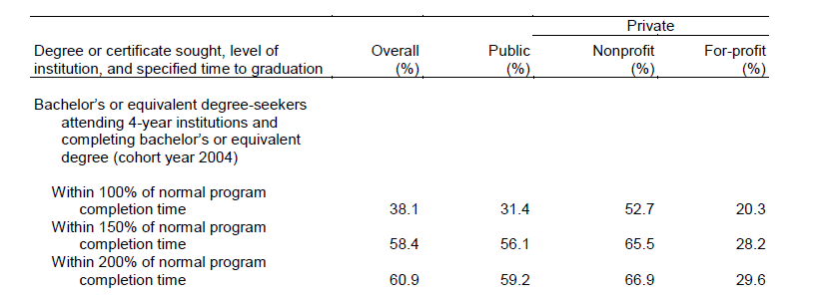
How Do Public Four-Year Institutions Do?
Graduation Rates (Student Right to Know - Fall, FT, FT, BA-seeking)

Slide 4
Time to Degree
Federal government does not collect institution (or program) level data on TTD. Only a single national sample survey (NCES, Baccalaureate and Beyond). Institutions and states have far richer information.
Clock Time
Time from first enrollment to degree for those starting and completing in same public four-year institution
4 or less 5 years 6 years 7 years 8 or >
51.4 30.6 8.6 5.4 4.2
Credits to Degree
Among BA Completers, same public four-year institution
Median Credits Earned 128 (vs. 125 private NFP four-year)
Many COSUAA institutions perform very well in graduation rates, but not in time to degree – students cross the finish line, but more slowly than is efficient. For example, UT-Austin, 53 (100%), 80 (150%), 83 (200%).
Calculate pseudo-TTD metric with ratio of 100/200. Perfectly efficient = 1 (83/83), located on 45 degree line. Red line is line (nonlinear) regression slope – institutions above it are worse than peers. And UT-Austin is burnt orange.

Slide 5
Efficiency of Degree Production in Public Four Year Institutions > 10,000 Enrollment
UT Austin

Slide 6
Efficiency of Degree Production in All Public Four Year Institutions

Slide 7
Does Pell Help – or Hurt -- Institutions in Improving TTD?
Median TTD among Public BA Grads, Pell vs. Not Pell (start/end same institution). Pell aided students take 12 months longer to BA than unaided.
All of us believe that it is not Pell award per se that is responsible for longer TTD, but differences between Pell-aided students and not.
Proposed solution? Statistical analysis (regression) in which many variables included to “control” for difference between Pell aided and unaided students
Finding? Using Baccalaureate and Beyond, nationally representative sample of BA grads, found “Pell Grant…negatively associated with time to degree when all of the independent variables in the regression were taken into account simultaneously” (NCES 2009-156)” (Pell coefficient – minus 11 months)
Bad theory. Bad measurement. Bad results.
Theory: why should Pell influence TTD? Let’s predict how long it will take Fall 2014 first-time students to complete. What do we want to know to accurately predict how long it will take them to finish?

Slide 8
Time to Degree Predictors?
Ability
Academic Preparation
Motivation/Commitment
Executive Function
Certainty of Degree Plans
Major Field of Study
Institution
Responsibility for Care of Dependents
Paid Work
Pell Award (?)

Slide 9
What Was Included and Excluded in Model?

Slide 10
Implications of What Was Left Out, and Solutions?
Some variables we need but can’t measure (e.g. motivation) – “unobservables”
Some variables are measurable, but not in the dataset we are using (e.g. ability).
Some variables are measured badly (e.g. preparation).
Some we don’t even know we need to measure!
Impact? Estimates for included variables – like Pell grant status -- are affected by what we have failed to measure, and are wrong (statistically, “biased”).
Solution? To make statements about impact of Pell – with confidence that our findings don’t reflect differences between Pell awarded students and those who are not – the best solution is a randomized controlled trial.. which…HEA does not permit.
Good news: There are experiments on Pell-like gift aid interventions. And, lots of “quasi-experimental” work that can produce strong findings about which behaviors are affected by grant aid. (Use naturally occurring variation in access to aid – not random – but is unrelated to outcomes between groups. B. Long: Florida Student Access Grant – $1,590 EFC cut off)

Slide 11
So, what behaviors are affected by grant aid?
Enrollment – Yes
Time To Degree – No
Progression and Completion? Mixed Results
Who? If impact, not on full sample/whole treated population, but those with very high risks (Wisconsin Scholars; Gates Millennium Scholars)
How? Not pure grant, but performance-based scholarship (e.g. minimum GPA and course load) (WVA Promise Scholarship, Scott-Clayton; MDRC CC experiments)

Slide 12
And non-aid interventions that promote success among Pell-eligible populations…
Pre-Matriculation
Early College High School (http://www.air.org/project/evaluation-early-college-high-school-initiative )
Dual Enrollment (http://ies.ed.gov/ncee/wwc/singlestudyreview.aspx?sid=20004)
What if it isn’t feasible to institute a new performance-based scholarship, or pre-college interventions?
Back to two practices already in use on campuses-- reducing risk, decoupling risk…

Slide 13
Reducing Risk Option One: Improve Risk Selection (9 million aided students, SAT 25/75/90th percentiles of 820/1090/1220)
Source: U.S. Department of Education, National Center for Education Statistics, Beginning Postsecondary Students Longitudinal Study, 2004/09 (BPS:04/09). Analytic sample: Degree-seeking undergraduates at public four-year institutions.

Slide 14
Problems with this?
Attrition risks difficult to forecast with accuracy
Arms race among schools
Misallocation of aid resources?

Slide 15
Or, decouple risk-taking and reporting
Graduation rate reporting (to ED) based on fall, FTFT, degree or certificate-seeking cohort. Institutions remove from cohort by:
Summer starts
Provisional fall admission
Credit-bearing mini course/special orientation
….if done, ideally in conjunction with research-based practices likely to increase success.

Slide 16
What Future for Pell in Time of Institutional Accountability?
Fiscal 2014 Omnibus Appropriations
…the Department is directed to submit a report to the House and Senate Appropriations Committees, no later than 120 days after the enactment of this act, on enrollment and graduation information for Pell Grant recipients for the 2012-2013 Pell Grant Award Year.” (Cohort start date 2012-13, 100 GR in 2017, and 200 GR in 2019).
Eventually, Pell Grant graduation rates (and TTD) for every recipient and at every Title IV institution.
Which will lead to questions about efficacy of program in general (Pell investment per degree completion)
And questions and how your institution is serving its Pell recipients in particular (who is “beating the odds”?)
More rigorous evidence of Pell impact and effective educational interventions for the populations it serves is needed.

